Slide 1
Environmental Management Sem-VIII Prepared By (Prof .Govind Wakure) (CSE(Data Science )

Slide 2
Chapter- 1 Introduction & Definition of Environment
Significance of Environment Management for contemporary managers, Carrier Opportunities
Environmental issues relevant to India.
The energy scenario

Slide 3
Introduction & definition of environment
Definition: Environment is the surroundings or control conditions in which all living organisms exist.
Our environment is everything that surrounds us, both natural and manmade.
Or the total sum of surroundings of living organism, including natural forces & other living things which provide conditions for development & growth as well as of danger & damage.
Or ENVIRONMENT: THE TOTAL OF OUR SURROUNDINGS • All the things around us with which we interact: • Living things • Animals, plants, forests, fungi, etc. • Nonliving things • Continents, oceans, clouds, soil, rocks • Our built environment • Buildings, human-created living centers • Social relationships and institutions
Thus the environment studies may vary from micro level to macro level.
Micro Level study: In case of some local studies such as ecosystem or solid waste management
Macro Level study: Global issues such as Green House Effect or Ozon depletion.

Slide 4
Types of pollutions: Air pollution, Water Pollution, Noise pollution, Land pollution
Pollution: It is deliberate or accidental contamination environment. Any manmade activity contributes to pollution. With rapid urbanization & industrialization. There has been tremendous burden on natural resources.
→Every human kind must be aware about the pollution & types of pollutions.
→All the engineers are directly or indirectly have the greater concern about environment and its types. Engineers are the best dealer of the ways & means to overcome them.

Slide 5
Main Features of environment
Environment comprises basically of living organisms (Biotic Factors) & nonliving factors (Abiotic factors) & their mutual interaction.
If proper balance between them then there is a healthy environment. (e.g. self sustaining ecosystem without the external interferences, especially man).
Due to unbalancing between above two factors a formation of Ecology is done, which is a part of environment. (degradation of environment)
(Unbalancing – e.g. when an industry discharges its waste in nearby water body, without proper treatment, there is an imbalance leading to degradation of environment & imbalanced ecology)

Slide 6
Biotic form (Any living part of an environment with which an organism might interact. Ex. Animals, plants, mushrooms, bacteria, etc. )
Autotrophs – Organisms that capture energy from sunlight or chemicals and convert it into forms, living cells can use.
Heterotrophs – can not make their own food; acquire energy from other organisms by ingesting (taking inside) them.
Producers – Make their own food.
Primary producers – the first producers of energy-rich compounds that are later used by other organisms.
→Autotrophs are primary producers!
→Most engage in the process of photosynthesis.
→Chemosynthesis – chemical energy is used to produce carbohydrates in dark conditions (like the deep oceans).

Slide 7
Consumers – organisms that rely on other organisms for energy and nutrients.
→Carnivores – kill and eat other animals.
→ Scavengers – consume the carcasses of dead animals.
Decomposers – chemically break down organic matter (bacteria and fungi are examples).
→Herbivores – eat plants.
→Omnivores – diets include both plant and animal matter.
→ Detritivores – feed on detritus (small pieces of decaying matter) by grinding them into smaller pieces (earthworms and snails are examples). Often digest the decomposers living on the detritus.

Slide 8
Abiotic factors (Nonliving part of the environment that influence the organism. Ex. Sunlight, heat, precipitation, humidity, wind, water current, soil type, etc.)
These factors mainly consist of non living part and can be broadly classified in following functional groups
Climatic factors: precipitation, light, temperature, atmospheric humidity & wind.
Physiographic factors:
→Factors that have their origin in the form, behavior
& structure of earth surface
→ Physical & chemical constituents of the soil, such
as its structure, chemical properties etc.

Slide 9
Need of environment studies (why to study environment)
(Basic needs are listed below)
Proper planning of urban, rural, industrial & economic developments.
To establish better communication amongst various parts of society in which we live.
To maintain the peace & harmony.
To control changing number of births, deaths, diseases (means demography) in a community over a period of time.
To control problems due to growing population which leads to – natural resources, healthcare services, educational institutions, water, sanitation & land, transport
To keep increase in crime & other social problems low.
To monitor problems of poor status of female & children.

Slide 10
Significance of Environment Management for Contemporary Managers
Environment takes into consideration all conditions required for the survival of corporate sectors.
Absence of environmental consideration causes serious ecological damage and a balance between the demands of economic development and the need for management of environmental process, precise knowledge of various facets of sound environmental managements is the sine qua non for sustainable development which meets the requirements of the present generation & coming generations as well
EM is especially valuable for internal management initiatives with specific environmental focus such as cleaner production, supply chain mgt initiatives, management system, environment mgt.
EM is more important not only for environmental mgt decisions but for all types of managerial functions with special emphasis on eco-efficiency and strategic position concept of environment management.

Slide 11
Following points shows the significance of EM:
1. EM gives idea about industrial development, a nation's economic progress and social welfare and the fulfillment of responsibility towards society.
2. Negotiation between the management and society
3. Pollution control being burning subject of discussion, EM
shows the extent to which pollution has been controlled by the corporate.
4. EM improves performance through better management of environmental cost and thus benefits the natural and human environments.
5. EM is helpful in discharging organizational accountability and increasing environmental transparency. Sustainable development is possible with the help of environmental management as it helps include ecological ability of enterprise.

Slide 12
6. Environmental management supports green reporting to combat effectively all negative public opinions in the global economy where existence of a strong environment lobby against environmentally unfriendly industries is found.
7. Environmental management reflects unsound production and consumption patterns, misuse and scanty use of resources and assets like: water.
Optimal allocation of scanty resources in the economy is possible with the help of environmental management.
8. Impressive decision taking through the application of environmental management reduce or eliminates many environmental problems.

Slide 13
Corporate Responsibilities:
1. Employees failing to observe environmental friendly code of conduct must be reprimanded.
2. Environmental friendly code of conduct must be noticed at all levels and by all the people.
3. Corporate commitment to environmental protection should be clearly stated.
4. Environmental protection is a genuine task and no stone will be left unturned in
preserving and safeguarding ecological balances.
5. Maintenance, replacement and repairs of machinery, tools, equipment, vehicles, etc. should be done properly and in time.
6. Alteration in product design should be made as far as possible to incorporate eco-friendly materials and other inputs.
7. Renewable sources of energies like solar energy, wind energy, etc. must be used and so advocated.
8. If the working of the corporate on any day or in any month is against environmental interest, staff doing this must seek apology.

Slide 14
Corporate Responsibilities:
9. Adequate number of PROs to communicate with the external world and to clear the corporate commitment to the world at large must be recruited.
10. Corporate manager should be proactive rather than active. The adequate measures must be initiated to protect environment before the new technology is put to use or adopted
11· Environmental engineers must be recruited for seeking their opinion on environmental related matters and for involvement in establishing a cleaner and efficient production system thereby minimizing wastage and ensuring optimum usage of all the raw materials.
12· Participation in activities like social forestry, community forest efforts, environment cleaning works, etc. may be made;
14. Environmental management is a response to human actions considering the increasing seriousness and significance of today's disastrous human impact on natural ecosystems.
15. It is comforting to know that with a smaller global population base and a less pervasive use of technology.

Slide 15
Corporate Responsibilities:
13. The audit report should contain the audit indings (or a summary of these findings) with reference to supporting evidence. Subject to agreement between the lead auditor and the MD, the audit report may also include the following:
i. the identification of the organization audited and of the client
ii. the agreed objectives, scope and plan of the audit
iii. the agreed audit criteria including a list of reference documents against which the audit was conducted
iv. the period covered by the audit and the date(s) the audit was conducted
v. the identification of the audit team members
vi. a statement of the confidential nature of the report contents
vii. the distribution list for the audit report
15. It is indeed expected that both conservationists and developers will come and work together over the need to make economic development sustainable, without it being undermined by long-term damage to natural resources and vital habitats.

Slide 16
Green House Effect
Environmental Issues Relevant to India
(Green house is a building made of glass in which plants are grown)
Meaning: Progressive warming up of Earths surface and air above it due to high concentration of manmade carbon dioxide in the atmosphere.
Concentration of CO2 works like a glass panel of greenhouse allowing short wave incoming solar radiation to come in but preventing the long wave heat to re-radiated out. (Natural outcome is warmer atmosphere)

Slide 17
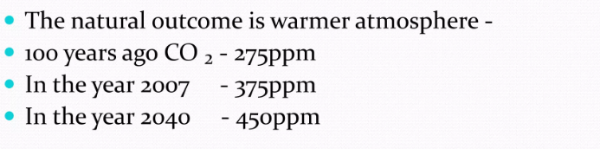
In air quality ppm is the number of molecules of CO2 per million air molecules.

Slide 18
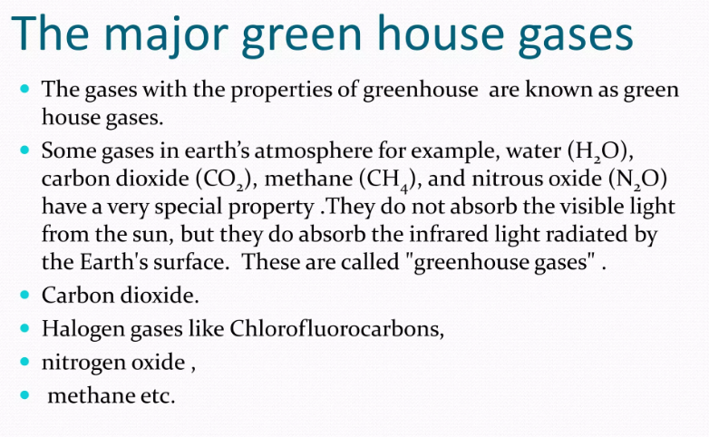

Slide 19
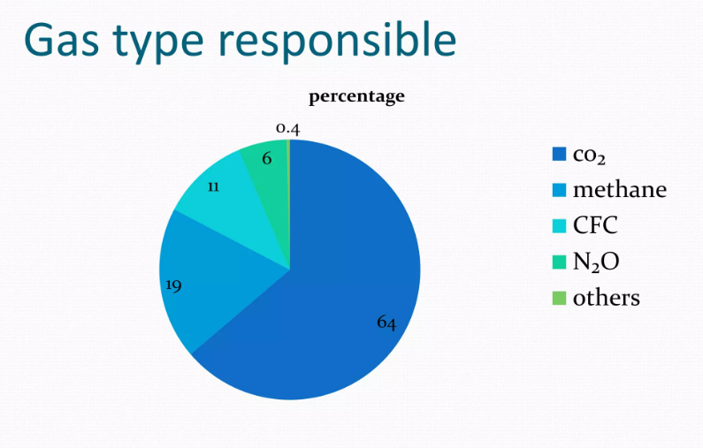

Slide 20
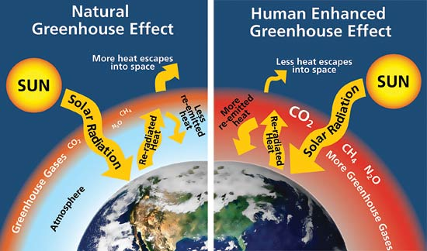
Greenhouse Effect
Some gases in earths atmosphere e.g. water (H2O), Carbon dioxide (CO2), methane (CH4), & nitrous oxide (N2O) have a special property. They don’t absorb the visible light but they do absorb the IR light radiated by Earths surface. These are called “greenhouse gases”

Slide 21
Sources of greenhouse gases
Thermal power stations based on fossil fuels, mainly coal and mineral oil emitting huge amount of CO2
Numerous factories and industrial chimney wastes
Automobiles
Deforestation and burning of fossil fuels.

Slide 22
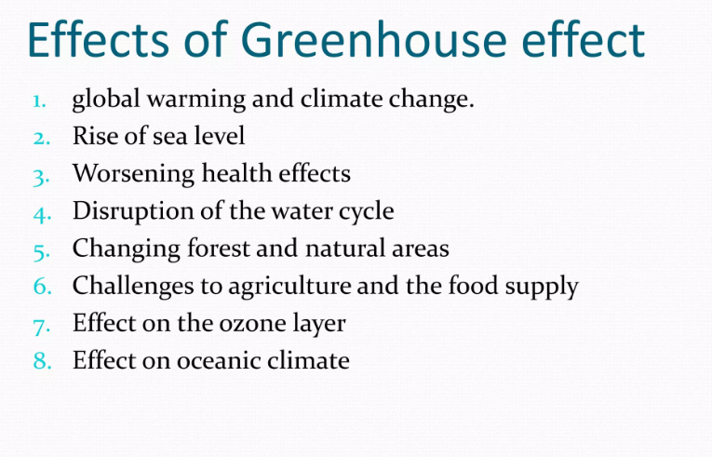

Slide 23
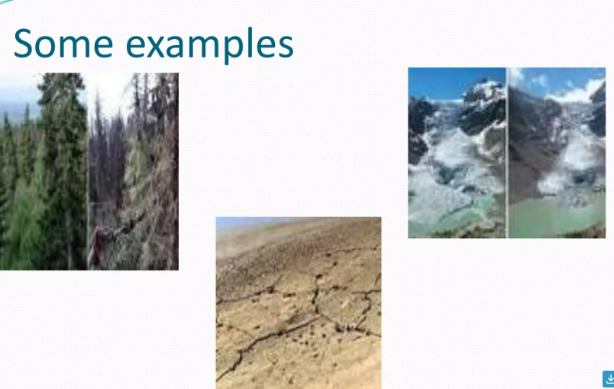

Slide 24
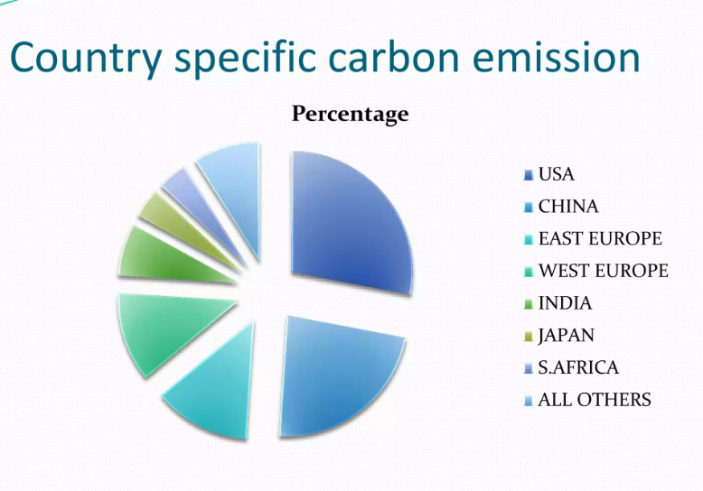

Slide 25
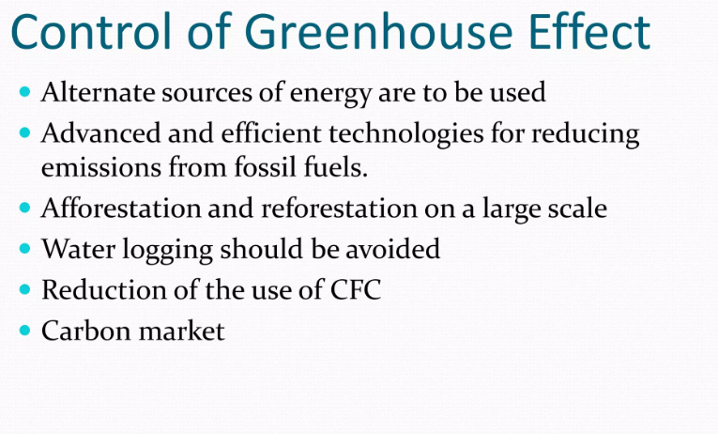

Slide 26
Climate change: It means a change in the global or regional climate patterns particularly from the mid to late 20th century onwards and mainly due to the increased levels of atmospheric carbon dioxide produced by the use of fossil fuels.
Global warming: It is the slow gradual rise in the temperature of the earth due to emission of excess
quantities of a number of radiation-tripping gases like
carbon dioxide, methane, chlorofluorocarbon, ozone,
nitrogen oxides which are together called as green house
gases.
Acid Rain: Its water contains higher acidity level due to dissolved CO2, sulphur oxides and nitrogen oxide gases, from the factories, mills etc.
→It causes damage to trees, crops, building and rivers.

Slide 27
Ozone layer depletion
Atmospheric ozone absorbs ultraviolet radiation from the sun which cause skin cancer and damage to cataracts and as well as damage to plants and marine ecosystems.
Chlorofluorocarbon (CFC) gases used as coolants in refrigerators cause depletion of this ozone layer, such that 1 atom of chlorine can destroy 100000 ozone molecules.
Nuclear accidents
They are mainly due to nuclear fusion, which cause explosion and also release dangerous radioactive radiations which affect the human life for decades together .

Slide 28
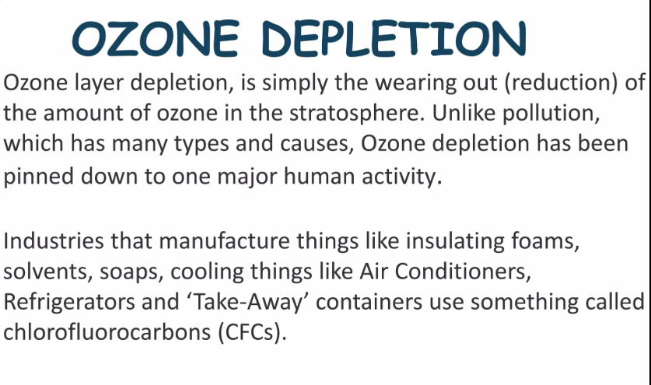

Slide 29
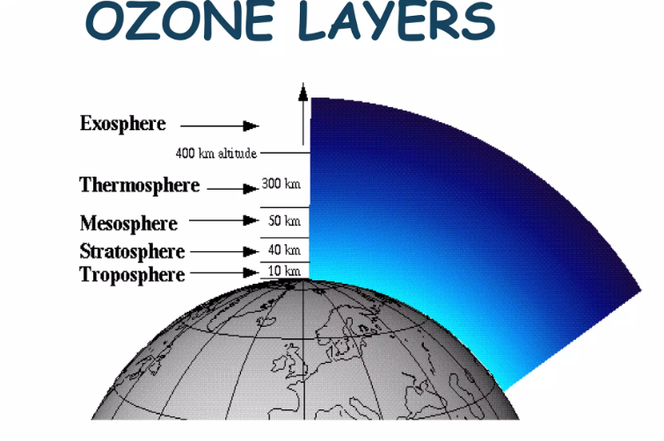

Slide 30
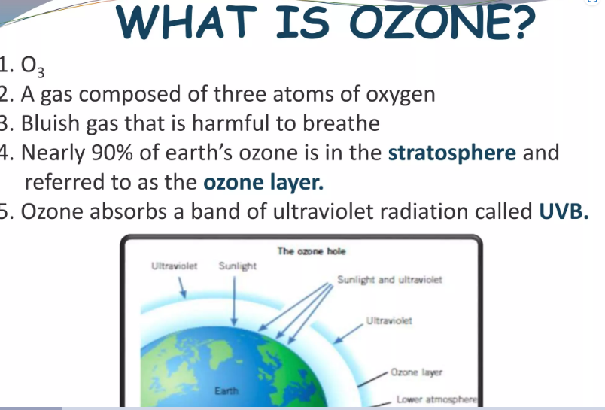

Slide 31
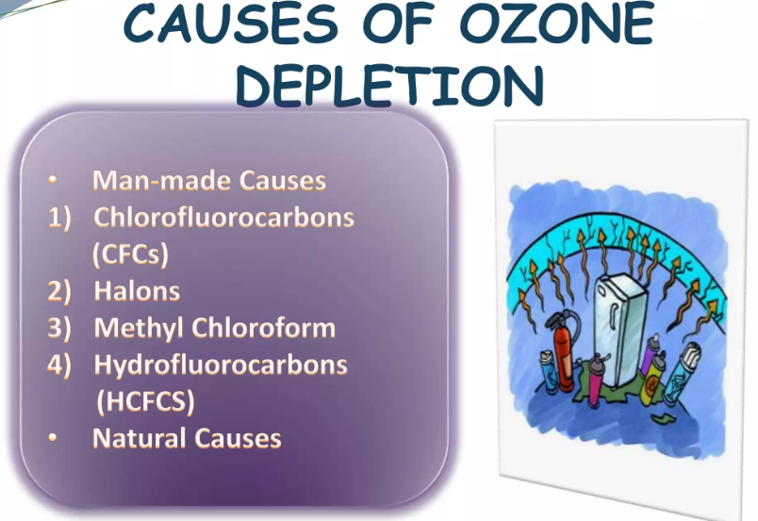

Slide 32
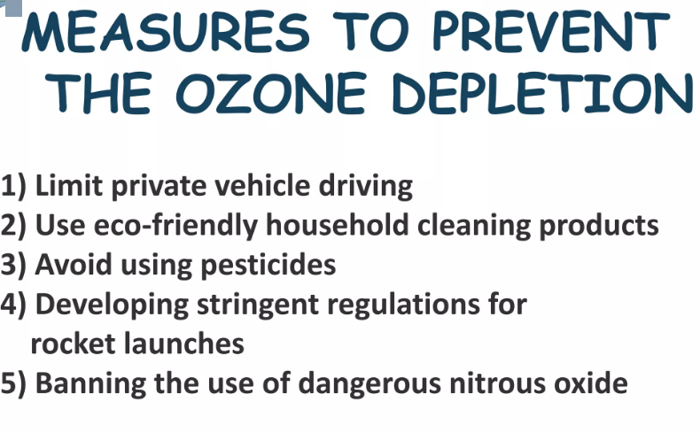

Slide 33
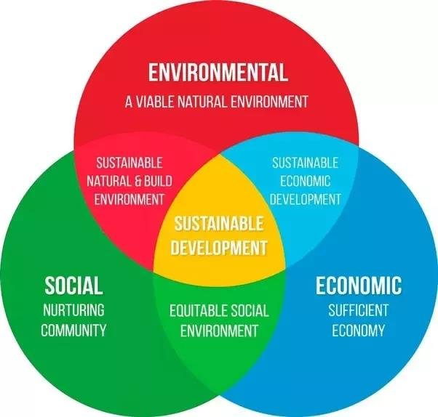
Sustainable Development
→Concept of sustainable development can be applied to many fields like economics, social, agriculture, environment etc.
→Aspects of sustainable development as follows :
(1) It must maintain a stable resource base means natural resources must be replenished at a faster rate than they are used up.
(2) It includes maintaining biodiversity, atmospheric stability and other ecosystem functions.

Slide 34
Sustainable Development
(3) Environmental-social aspect of sustainability deals with our interactions with the environment. This include designing and planning of our home and cities, care of our available resources. It also includes the ways we interact with the environment.
(4) Environmental-Economic aspect of sustainability includes the interaction between environment and economics. Environmentally products must be used commonly and widely so that these are less hazardous to us and our environment with respect to their packages, garbages, left overs and also their prices are less and affordable to us economically. Thei r wide-spread use will further out their prices and make them more and more economical.
(5 ) Thus concept of sustainable development is of great importance for stabilizing public economy and growth per capita.
( 6 ) Establishing more industries, agricultural activity and job opportunities.

Slide 35
Engineer's Role in Achieving Sustainable Development
18/12/2022
A new concept in environmental and human affairs was introduced with the Brundtland Declaration of 1987: "Sustainable development is development that meets the needs of the present without compromising the ability of future · generations to meet their own needs."
All the development that is taking place in developing countries like India is putting more and more pressure in the urban areas rather than the rural areas. Hence understanding the need of urban sustainability is very important issue at present.
{In 1987, the World Commission on Environment and Development (WCED), Gro
Harlem Brundtland was the chairwoman of this commission….accordingly
Brundtland report or declaration.}

Slide 36
Urban Sustainability (causes)
Deforestation, growing desserts, soil degradation and loss of wild life species are occurring across the globe.
Cities are growing faster than government can develop infrastructure services for them.
Slums surrounding the cities are causing serious health pollution. Cities are huge consumers of water, electricity, fossil fuels and nutrients.
An ideal Sustainable city should have a circular metabolism where it uses only local resources and all wastes are recycled back into the system.
While large Chinese cities like Shanghai have been able to sustain this way of living until fairly recently, pressure for urbanization and global trade is destroying their sustainability, while easier accessible forms of energy like coal, are creating tremendous pollution problems.

Slide 37
Urban Sustainability
➔ The remedies for more sustainable resource utilization includes
the following :
More efficient energy use and utilizing energy from renewable resources.
More efficient public transport systems.
More compact cities to reduce consumption of fossil fuels through automobile traffic.
Water management by appropriate landscaping.
More efficient recirculation systems like grey water management and reduced burden on civic bodies for wastewater treatment.
More efficient recycling of inorganic wastes (glass, plastics, metals and chemicals)
More efficient recycling of organic wastes like sewage an clinical wastes.
Taking all the above said aspects into account, it is clear that the whole construction industry has then a significant impact, both directly an indirectly, on achieving sustainable development in the urban environment.)

Slide 38
Role of Construction Sector for Sustainable Development
Main challenges faced by the construction sector are :
Urban and rural area planning
Life cycle design of buildings
Production and manufacture of building materials
Site production and manufacture
Organizing the entire building processes
Facility management of buildings
Recycling and waste management.
Clients, owners, developers and investors should have important role in
disseminating sustainable construction, since they represent the demand of the
building sector. Planning system should be altered in order to promote
sustainable development.
Individual car use should be reduced and car-pooling should be promoted, use of public transport system should be increased.
Home working and combining office and living space should be increased. More open spaces and green areas should be developed and reserved in the planning stage itself.
As far as construction is concerned, the rules, standards, and certification schemes for sustainability and eco compatibility should be introduced in the design activity of any project.

Slide 39
Role of Engineers towards Achieving Sustainable Development
Engineers play a vital role in the development of the society at large. They face many hurdles in their respective fields, as follows :
The Engineers have to face and overcome following hurdles
They generally have to work within their national framework of law and policy: otherwise their contribution can be constrained.
Wide variation in the perception of responsibility to future generations and ethical issues.
The downgrading of environmental concerns in times of economic decline.
Need for professional capacity to understand and implement cleaner production and Sustainable Development objectives at levels of responsibility.

Slide 40
Role of Engineers towards Achieving Sustainable Development
The role of engineers: Engineers from all disciplines can play a vital role in achieving sustainability.
The Engineer must possess an initiative in Eco-efficiency to consider setting a target of achieving a many-fold improvement in production in the long term with a possible increase in the next two decades.
Fresh water to be given the "highest priority". A strategic approach has to be reached to preserve, protect and supply fresh water.
Safe substitute for toxic chemicals should be developed and those technologies shall be transferred to developing countries. Hazardous wastes, like radioactive wastes should be disposed off in the country in which they were originated. ·
Efficient use of materials and energy.
A major effort in reducing greenhouse gas emissions; this involves sustainable energy, new technology and energy efficiency.
Support for internalization of environmental costs in energy pricing and for transfer of clean technologies to developing countries.

Slide 41
Role of Engineers towards Achieving Sustainable Development
Engineers must become knowledgeable in achieving sustainable development principles and must be continuously trained about the current sustainable development
Technologies applicable to their area of work, may be computers, Electronics,
Biotechnology or any core branch of Engineering.
Engineers must incorporate long-term environmental impacts and cost into the analysis of alternative solutions being considered.
Engineering responsibilities must be re-addressed by incorporating sustainable development principles into the codes of ethics of engineering organizations throughout the world.
Engineers must continuously participate in public explanation of the principles of sustainable development as relate to their profession.

Slide 42
Environmental Impact Assessment
19/12/2022
For execution of any big development project, an EIA is mandatory these days. EIA is a tool to predict the impacts or the damage a project will have on the environment, when the project is executed.
There are @ 30 categories of industries for which Environmental Clearance from Central Government is required in India.
Any development projects such as Construction of Dams, construction of Thermal Power Plants, Nuclear Power Plants, have some adverse (negative) as well as some beneficial (positive) impacts on environment.
These impacts or damages are to be analyzed critically before the project is taken up.

Slide 43
Environmental Impact Assessment
The main objectives of EIA are :
To analyze the ill effects of any up-coming project on the environment in a rational manner i.e. the study shall be unbiased.
To suggest remedial measures to overcome the adverse impacts, thus reducing the pollution.
To obtain required environmental clearances from the concerned authorities such as Central Pollution Control Board (CPCB), State Pollution Control Board (SPCB), Ministry of Environment and Forest (MoEF) etc.
To select suitable site(s) for the project taking into consideration the environmental impacts of the project vis-a-vis cost-benefit analysis(CBA)
Following points are suggested for carrying out an EIA :
1. Status of existing environmental conditions
2. Study of project activities
3. Suggestions to minimize adverse effects
4. Pollution abatement
5. Identifying damages

Slide 44
1. Status of existing environmental conditions
A detailed study of prevailing environmental conditions in and around the study area is required to be carried out, before starting any project.
All the parameters such as physical (water, air, land etc;) and social environment (economical conditions, employment status, cultural & historical importance etc.) should be studied in detail.
It shall be specifically noted that, whatever may be the benefits of the project, the present environmental conditions and quality of life shall not get disturbed due to the project under consideration.

Slide 45
2. Study of project activities
For any project, there are various activities involved right from its conceptualization to completion.
Even in a manufacturing industry, during the manufacturing of any product, understating the process details including raw material requirement, waste generation from different sources needs to be understood completely before carrying out an EIA.
In case of mega projects like dams or road projects, sometimes alternative sites are suggested as the project activities for such projects like noise during construction or due to traffic movement may disturb the species in the nearby forest reserves .

Slide 46
3. Suggestions to minimize adverse effects
On completion of some project, it is likely that the project will have adverse impacts on the environment either due to construction or during running of the industry .
The waste discharged in the Environment from a particular industry such as a sugar industry, may have harmful elements in it.
Hence proper measures to curb pollution from such industries should appear in an EIA report. This will help to reduce the damage to the environment.

Slide 47
4. Pollution abatement
Pollution prevention is not a difficult task these days. Many techniques are available for reducing all types of pollutions such as pollution of Air, Water, Land etc.
The treatment methodologies should be incorporated in the project management itself. This will help to curb the pollution to a great extent.
It is very easy to assess the likely adverse impacts or the damages to the environment due to the project under consideration, once the treatment technologies are incorporated in the Environment Management Plan (EMP) of the Project under consideration.

Slide 48
5. Identifying damages
In almost all projects, there will be some or the other adverse impacts· There can be short term or long term effects of a project which are reversible or irreversible.
Effects may be restricted to local scale (e.g. surrounding area of an Industry or may have effects on global scale, such as emission of Green House Gases.
Quantifying the damages is also an important task for predicting the likely impacts.
The intensity and duration of exposure of a particular pollutant are equally important for establishing the damage.
For example, exposure to vehicular pollution even for a small duration, increases the level of Carbon Monoxide (CO). It reacts with blood to form COHb i.e. Carboxy Hemoglobin. However , this is a reversible reaction and hence, after some time again CO gets removed from the blood.
On the other hand, some toxic elements such as lead may not show any immediate ill-effects but may get accumulated in blood over a longer period causing some permanent damages.
The likely damages due to a project are also required to be categorized as significant or insignificant and primary (direct) or secondary (indirect).

Slide 49
Energy Scenario
Energy has prime importance for the economic development of any country.
Classification of Energy
1. Primary and secondary energy.
2. Commercial and non commercial energy.
3. Renewable and Non-Renewable energy.
➔1. Primary and secondary energy:
Primary energy sources: are found or stored in nature. Common primary energy sources are coal, oil, natural gas, and biomass (such as wood), nuclear energy from radioactive substances, thermal energy stored in earth's interior and potential energy due to earth's gravity.
Secondary energy sources: Gasoline liquid, fuel oil, biofuels, Electricity, Hydrogen, Heat, compressed air, microwave radiation.

Slide 50
2. Commercial and non commercial energy.
(i) Commercial energy
The energy sources which are available in the market for a definite price are called as commercial energy.
Commercial energy forms the basis of industrial, agricultural transport and commercial development in the modern world.
Examples : Electricity, lignite, coal, oil, natural gas etc.
(ii) Non-commercial energy
The energy sources which are available in the commercial market for a price are classified as non-commercial energy.
Example .: Firewood, agro waste in rural areas, solar energy for water heating, electricity generation, for drying grain, fish & fruits, animal power for transport, threshing, lifting water for irrigation, wind energy for lifting water& electricity generation etc.

Slide 51
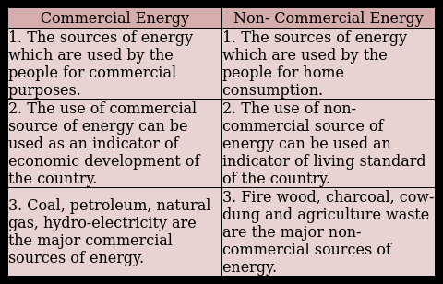
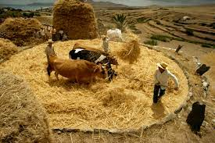


Commercial and non commercial energy.
Threshing

Slide 52
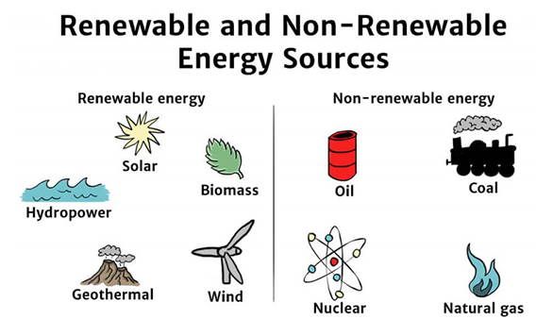
3. Renewable and Non-Renewable energy.
→Renewable energy is energy which is obtained from sources that are essentially inexhaustible. (e.g. wind power, solar power, geothermal energy, tidal power, hydroelectric power).
→The most important feature of renewable energy can be harnessed without the release of harmful pollutants.
A non-renewable resource is a natural resource that cannot be readily replaced by natural means at a pace quick enough to keep up with consumption. An example is carbon-based fossil fuels. The original organic matter, with the aid of heat and pressure, becomes a fuel such as oil or gas

Slide 53
3. Renewable and Non-Renewable energy.
→Renewable energy is energy which is obtained from sources that are essentially inexhaustible. (e.g. wind power, solar power, geothermal energy, tidal power, hydroelectric power).
→The most important feature of renewable energy can be harnessed without the release of harmful pollutants.
A non-renewable resource is a natural resource that cannot be readily replaced by natural means at a pace quick enough to keep up with consumption. An example is carbon-based fossil fuels. The original organic matter, with the aid of heat and pressure, becomes a fuel such as oil or gas

Slide 54
Tidal Power
25/01/2022
➔Tidal energy is a form of hydropower that converts energy obtained from tides into useful forms of power, such as electricity. Tides are created by the gravitational effect of the moon and the sun on the earth causing cyclical movement of the seas.
Advantages of Tidal Energy
➔Reliable and renewable source of energy. High energy density than other renewable energy forms. It produces no greenhouse gases or other waste. Vertical-axis turbines and offshore turbines are inexpensive to build and have less environmental impact.

Slide 55
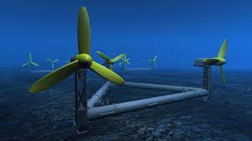
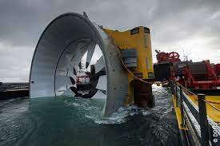
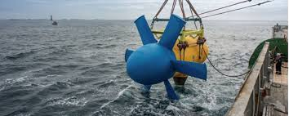

Tidal Power

Slide 56
Indian Energy Scenario
➔Coal dominates the energy mix in India, contributing to 55 % of the total primary energy production.
➔Over the years, there has been a marked increase in the share of natural gas in primary energy production from 10 % in 1994 to 13 % in 1999.
(i) Coal supply
India has 5th largest coal reserves, at least 106 billion tons of proven recoverable reserves (at the end of 2019→ 2020 survey).
This amounts to almost 10 % of the world reserves and it may last for about 290 years at the current Reserve to Production.
Odisha and Chhattisgarh in the east of the country are the states containing the largest coal deposits.
(ii) Oil supply
Oil accounts for about 36 % of India's total energy consumption
India today is one of the top ten oil-guzzling nations in the world

Slide 57
Indian Energy Scenario
(iii)Natural gas supply
Natural gas accounts for about 6.7 (2020) per cent of energy consumption in the county.
Natural gas reserves are estimated at 660 billion cubic meters.
(iv) Electrical energy supply
The all India installed capacity of electric power generating stations under utilities was 3,93,389 MW as on 31st Dec. 2021,
It consisting of 1,51,391 MW-hydro, 2,32,219 MW-thermal and 6,780 MW-nuclear and 40,083 MW-wind (Ministry of Power).
(v) Nuclear power supply
Nuclear power contributes to about 2.4 per cent of electricity generated in India.
India has ten nuclear power reactors at five nuclear power stations producing electricity.
(vi) Hydro power supply
India is endowed with a vast and viable hydro potential for power generation of which only 11.9 % has been harnessed so far.

Slide 58
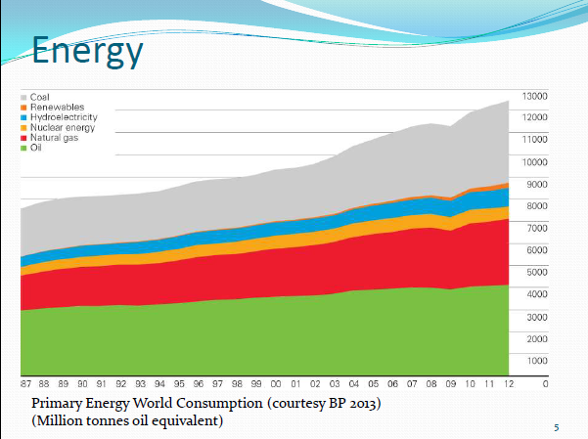

Slide 59
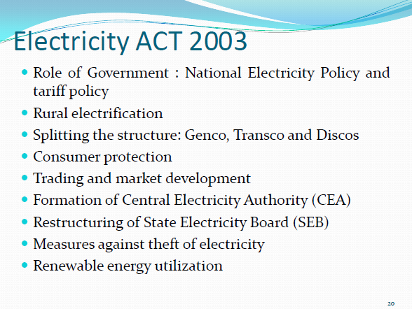

Slide 60
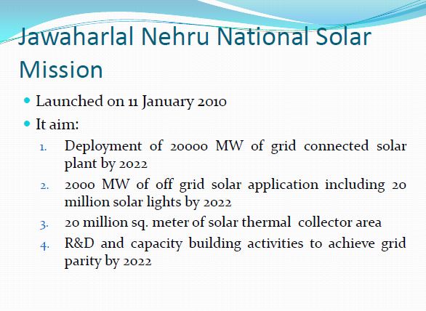

Slide 61
Thank you

